Slide 1

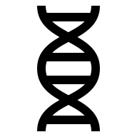
3D Genomic structure
Paweł Dąbrowski-Tumański
MiNI Lecture, Fall 2025

Slide 2


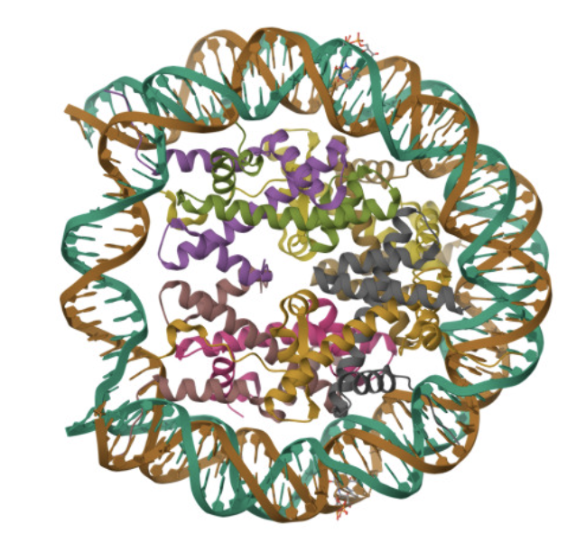




WHY 3D STRUCTURE MATTERS
🧬 DNA is not just linear – it has 3D structure
❓Question: How might shape influence function?

Slide 3
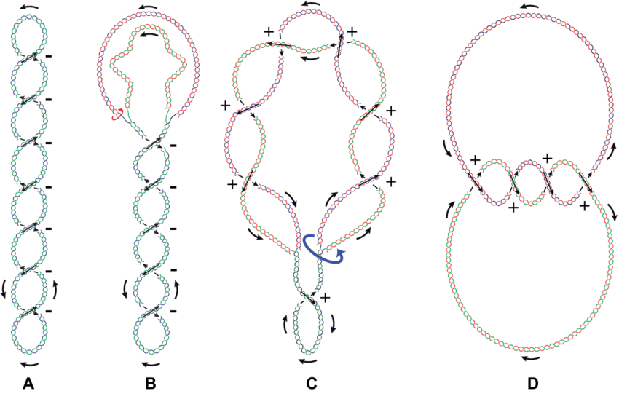
WHY 3D STRUCTURE MATTERS
🔄 Topology affects replication, transcription, recombination

Slide 4
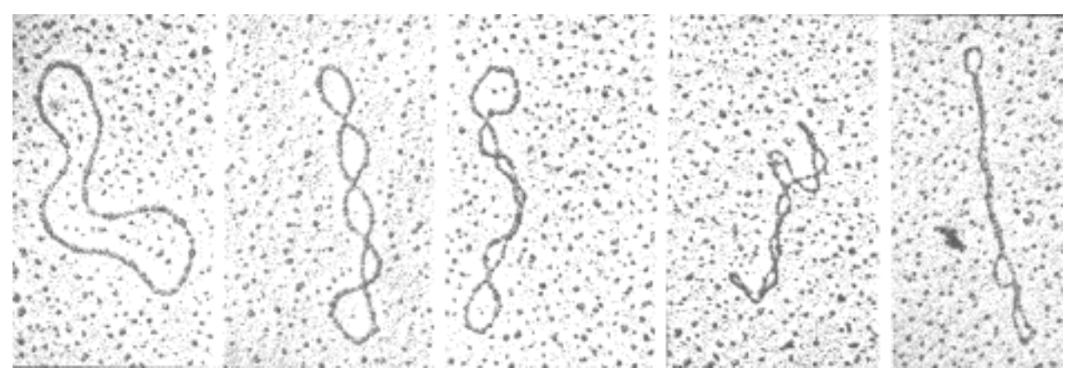
SUPERCOILING
🧪 DNA accumulates torsional stress during transcription

Slide 5
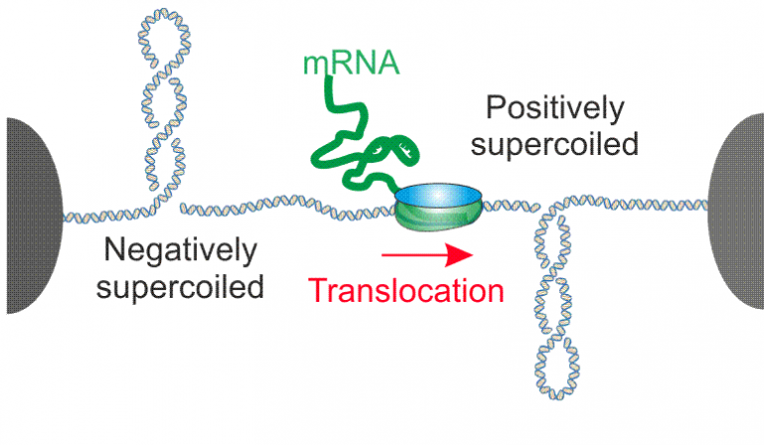
SUPERCOILING
➕ Positive supercoils ahead of polymerase, ➖ Negative behind
🔧 Influences enzyme access and nucleosome positioning

Slide 6
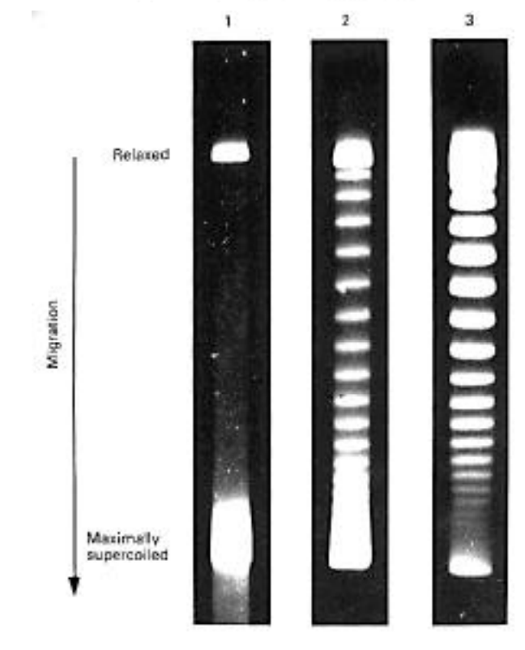
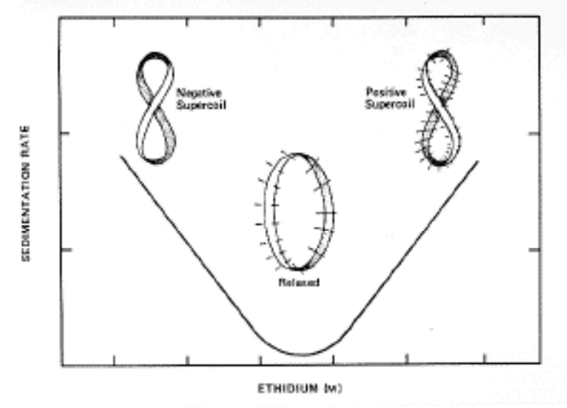
SUPERCOILING - PHYSICAL PROPERTIES

Slide 7
SUPERCOILING
❓Could supercoiling act as a regulatory signal?

Slide 8
LINKING NUMBER, TWIST, WRITHE
➿ Linking number: total number of DNA turns
🔄 Twist: rotations along DNA axis
🌀 Writhe: supercoiling of the double helix
💭 Analogy: rope coiling in 3D space

Slide 9
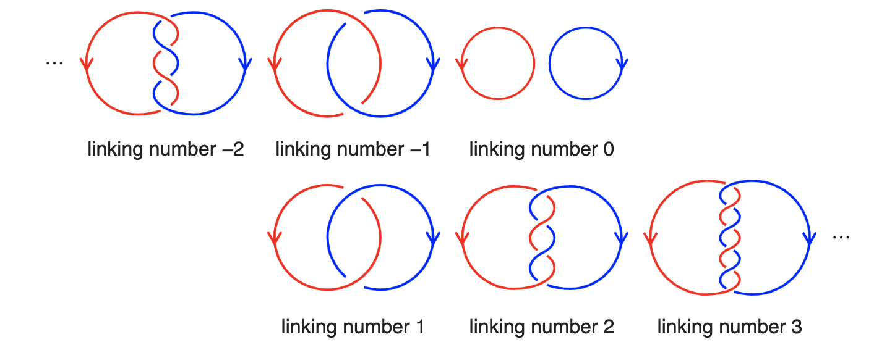
LINKING NUMBER, TWIST, WRITHE
➿ Linking number: total number of DNA turns

Slide 10
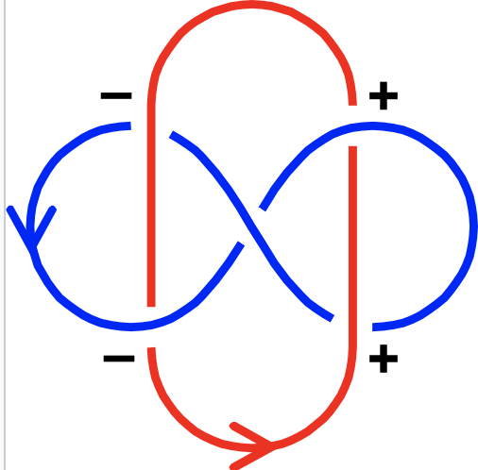
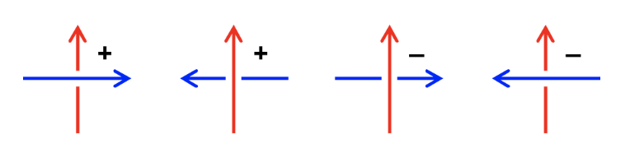
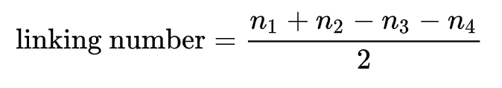
LINKING NUMBER, TWIST, WRITHE

Slide 11
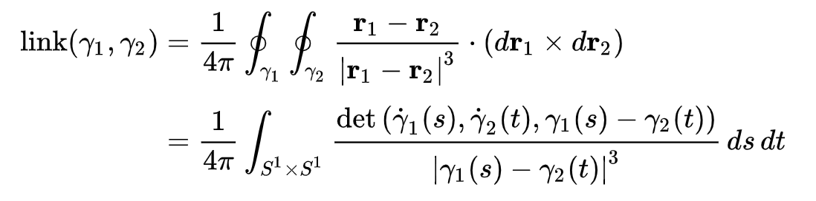
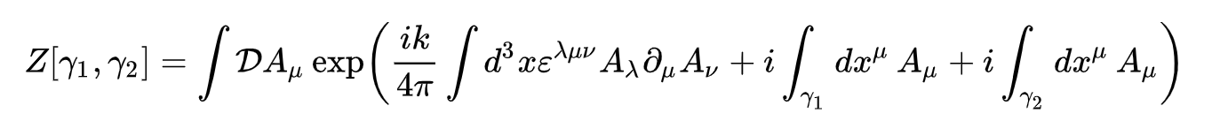
LINKING NUMBER, TWIST, WRITHE

Slide 12
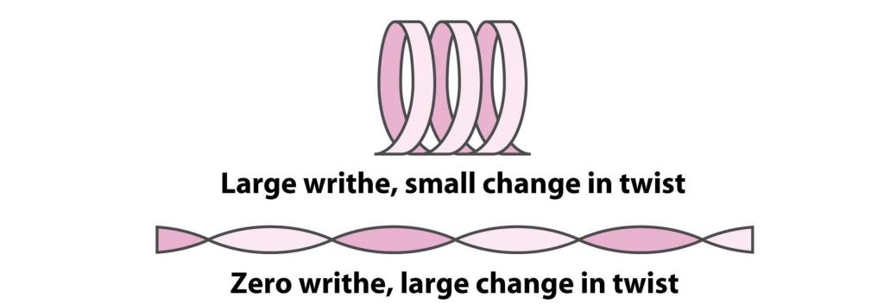
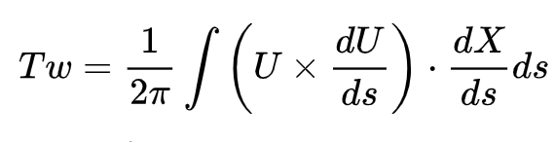
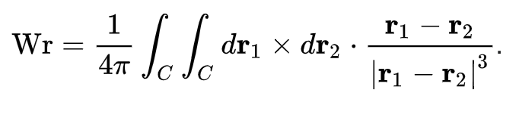
LINKING NUMBER, TWIST, WRITHE

Slide 13
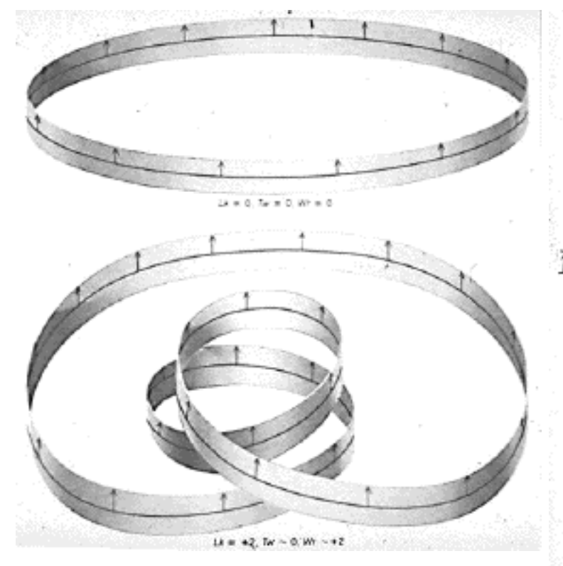
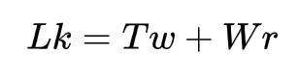
LINKING NUMBER, TWIST, WRITHE

Slide 14
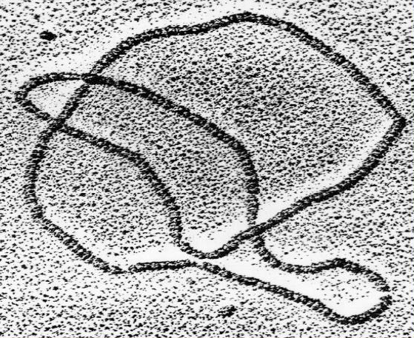
KNOTS IN CIRCULAR DNA

Slide 15
KNOTS IN CIRCULAR DNA
🔗 Circular DNA can form knots during replication
🎲 Probability increases with length and supercoiling
🧬 Knots interfere with transcription and segregation

Slide 16
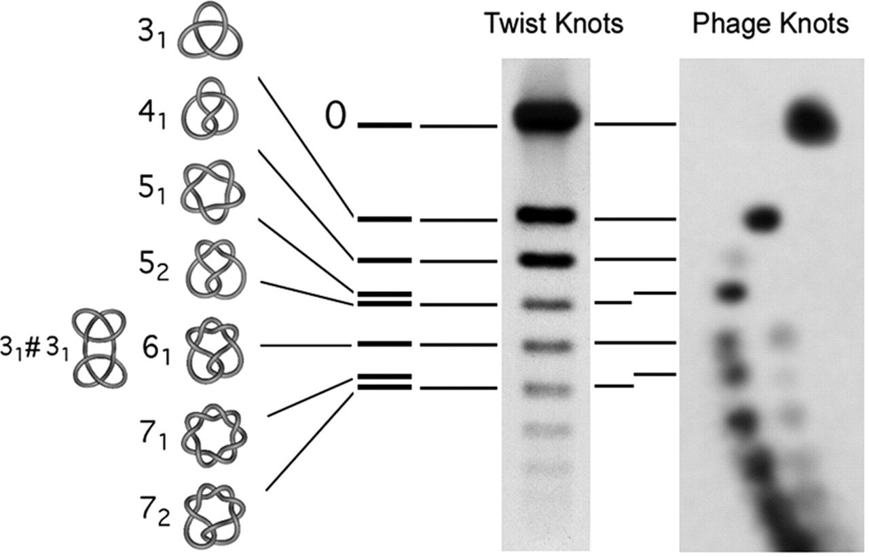
GEL ELECTROPHORESIS
🧫 DNA topology affects migration speed in gels

Slide 17
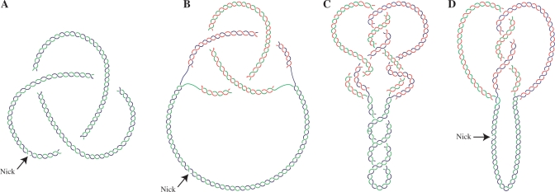
Θ-CURVES DURING REPLICATION
🔄 Replication of circular DNA forms θ structures

Slide 18
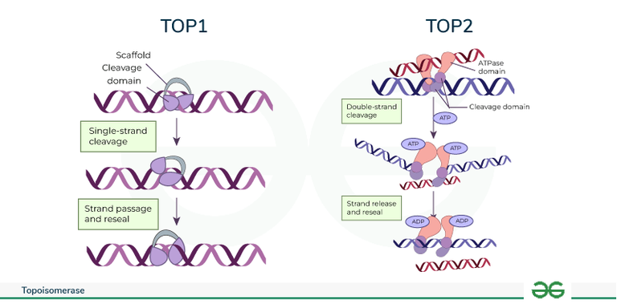
TOPOISOMERASE I
✂️ Introduces single-strand breaks to relax torsion
🔄 Does not require ATP
🧬 Essential for transcription and replication

Slide 19
TOPOISOMERASE II
✂️ Makes double-strand breaks to pass DNA segments
⚡ Requires ATP
🪢 Resolves knots and catenanes

Slide 20
ROLE OF TOPOISOMERASES
🧩 Prevent supercoiling accumulation
🔄 Facilitate fork progression and recombination
🧬 Maintain transcriptional fidelity
💭 Analogy: traffic controllers of DNA strands

Slide 21
TOPOISOMERASE ASSAYS
🧬 Knots and catenanes are enzymatic targets
🔧 Topoisomerase assays detect activity based on gel patterns
🧪 Functional readout for replication and transcription studies

Slide 22
EXPERIMENTAL VISUALIZATION
🧫 Gel electrophoresis for topology assessment
🔬 Electron microscopy and AFM
⚡ Optical tweezers to measure torsion
💡 Combine with computational models for insights

Slide 23
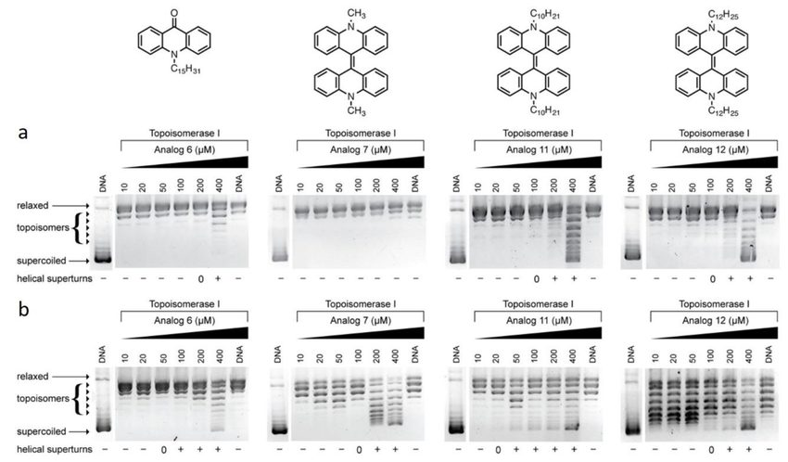
EXPERIMENTAL VISUALIZATION

Slide 24
MODELING OF DNA AS POLYMERS
💻 DNA modeled as flexible polymers
🎲 Monte Carlo methods sample conformations
🌀 Predict supercoiling, knot probability, dynamics
💡 Link physical models to biological function

Slide 25
TOPOLOGY VS GENE EXPRESSION?
❓ Could supercoiling act as a regulatory mechanism?
❓ How do knots or torsional stress affect transcription?
💭 Could cells exploit topology for rapid response?

Slide 26

BASE PAIRING AND LOOPS
🧬 RNA folds into stems, loops, bulges, and hairpins
🔄 Base pairing rules govern local structures
💡 Structure influences translation and stability
❓How might small changes affect function?

Slide 27
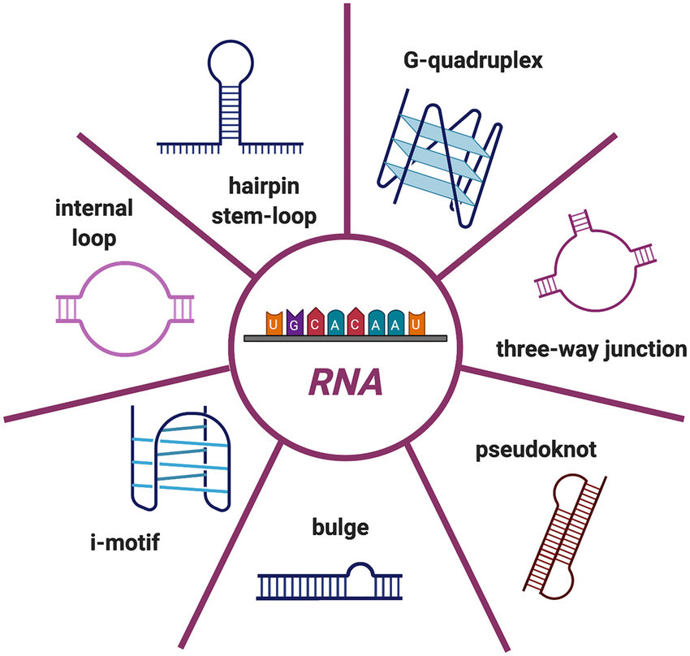
BASE PAIRING AND LOOPS

Slide 28
NUSSINOV AND ZUKER ALGORITHMS
💻 Predict RNA secondary structures efficiently
🔢 Nussinov maximizes base pairs, Zuker minimizes free energy
🧠 Useful for long sequences and comparative analysis

Slide 29
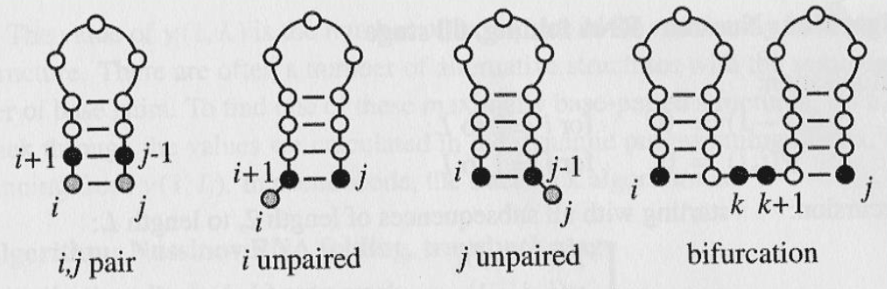
NUSSINOV AND ZUKER ALGORITHMS

Slide 30
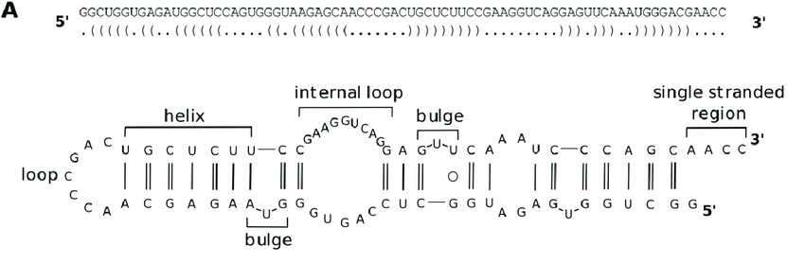
BRACKET NOTATION

Slide 31
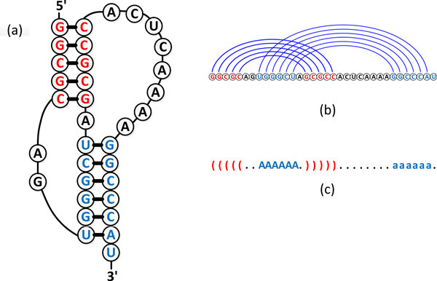
PSEUDOKNOT PREDICTION

Slide 32
PSEUDOKNOT PREDICTION
🪢 Pseudoknots involve overlapping base pairs
⚡ Exact prediction is computationally difficult
🧰 Heuristics and approximations used in practice
💭 Important for ribozymes, telomerase RNA, and viral RNA

Slide 33
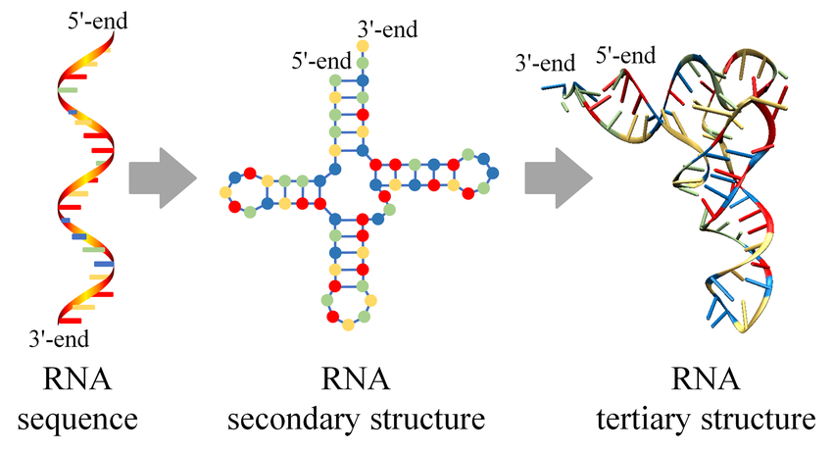
RNA TERTIARY STRUCTURES

Slide 34
RNA TERTIARY STRUCTURES
🧩 Complex 3D arrangements beyond secondary structure
🔬 Influences catalysis, binding, and regulation
📚 Studied via NMR, X-ray, Cryo-EM

Slide 35
DATABASES
🌐 RNAcentral: comprehensive RNA sequences and annotations
🧬 PDB: experimental 3D structures
💾 Allows computational predictions and model validation

Slide 36
STRUCTUR INFLUENCES RNA FUNCTION
❓ Can misfolded RNA cause disease?
💭 How do viruses exploit RNA structure?
🧠 Could structure prediction inform synthetic RNA design?

Slide 37

CHROMATIN CONFORMATION CAPTURE
🧬 3D genome organization is critical for regulation
🔬 Techniques capture physical contacts between chromatin regions
💡 Provides insight into enhancer-promoter interactions

Slide 38
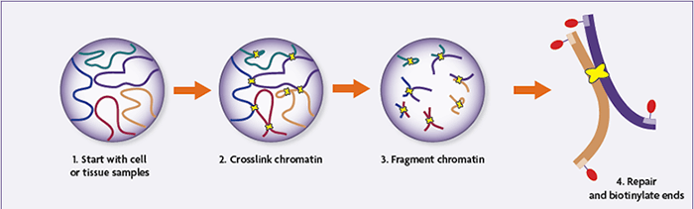
HI-C: GENOME-WIDE INTERACTION MAPPING
🧫 Crosslink → digest → ligate → sequence workflow

Slide 39
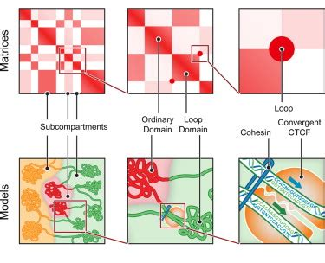
HI-C: GENOME-WIDE INTERACTION MAPPING
📊 Produces contact matrices representing genome interactions

Slide 40
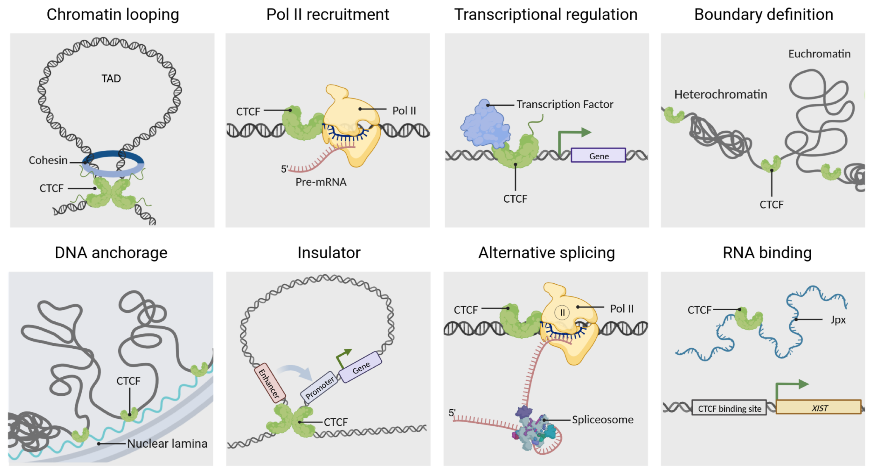
TADS BOUNDARY

Slide 41
MICRO-C
🔬 Higher resolution than Hi-C
🧬 Maps contacts at nucleosome scale
⚡ Reveals fine-grained chromatin folding
💡 Useful for studying gene regulatory elements

Slide 42
CHIA-PET
🧬 Captures chromatin contacts mediated by specific proteins
🔗 Combines ChIP and 3C principles
💡 Highlights enhancer-promoter loops

Slide 43
HICHIP AND PLAC-SEQ
🔬 Combines ChIP enrichment with Hi-C contact mapping
🧩 Detects interactions of proteins with chromatin
💡 Efficient for studying transcription factors

Slide 44
CONTACT MAPS
📊 Matrices show interaction frequency between loci
❌ Sparse matrices at high resolution
🔧 Systematic biases need correction

Slide 45
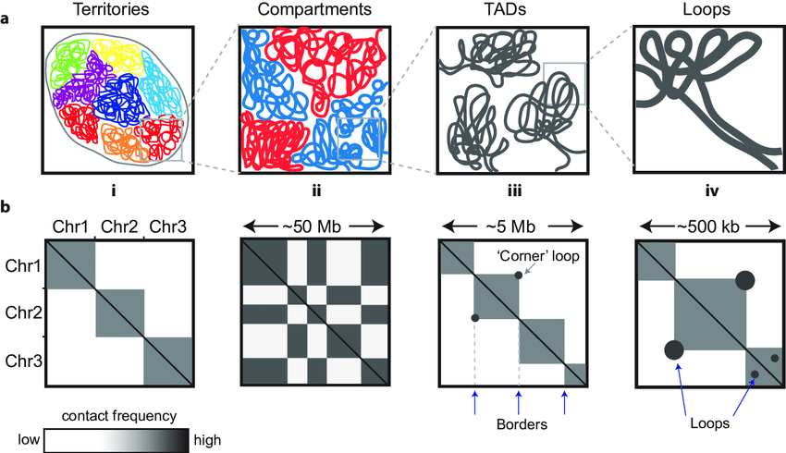
CONTACT MAPS

Slide 46
NORMALIZATION METHODS
⚖️ Corrects for biases in Hi-C data
🔄 ICE: iterative correction and eigenvector decomposition
🔧 KR: Knight-Ruiz matrix balancing

Slide 47
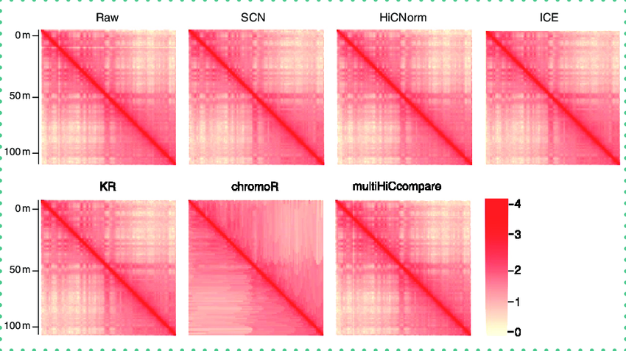
NORMALIZATION METHODS

Slide 48
LOOP DETECTION: HICCUPS, FIT-HI-C
🔍 Identify statistically significant loops
📈 HiCCUPS: peak calling in normalized matrices
📊 Fit-Hi-C: models distance-dependent contact probability
💡 Crucial for enhancer-promoter discovery

Slide 49
TAD DETECTION
📏 TADs are self-interacting genomic regions
🔧 Insulation score measures boundary strength
📊 Directionality Index quantifies upstream/downstream bias
💡 HMMs identify TADs computationally across the genome

Slide 50
COMPARTMENT ANALYSIS
🔄 A/B compartments reflect active/inactive chromatin
📊 PCA on normalized maps
🧬 Correlates with histone marks and gene expression

Slide 51
STRUCTURAL VARIATION DETECTION
⚡ Detect deletions, duplications, inversions, translocations
🔬 HiCnv: uses coverage deviations
🧩 hic_breakfinder: breakpoint detection from contact maps

Slide 52
DEEP LEARNING FOR 3D GENOMICS
🤖 Akita: predicts contact maps from DNA sequence (CNN)
🔧 DeepC: predicts genome contacts from sequence features
⚡ HiCPlus: super-resolution enhancement of Hi-C data

Slide 53
GNN AND VAE FOR 3D STRUCTURE
🧠 GNNs capture topological chromatin features
🔄 VAEs infer latent 3D structure from contact matrices
💡 Useful for modeling heterogeneous and single-cell data

Slide 54
CHROMATIN CONFORMATION DATABASES
🌐 Central repositories of 3D genome data
🧬 Include experimental and computational annotations
🔧 Useful for comparative and integrative studies

Slide 55
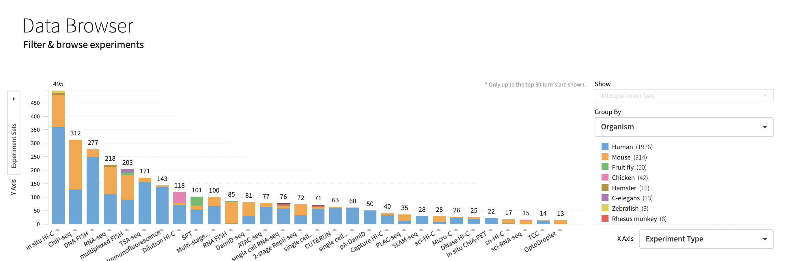
4D NUCLEOME

Slide 56
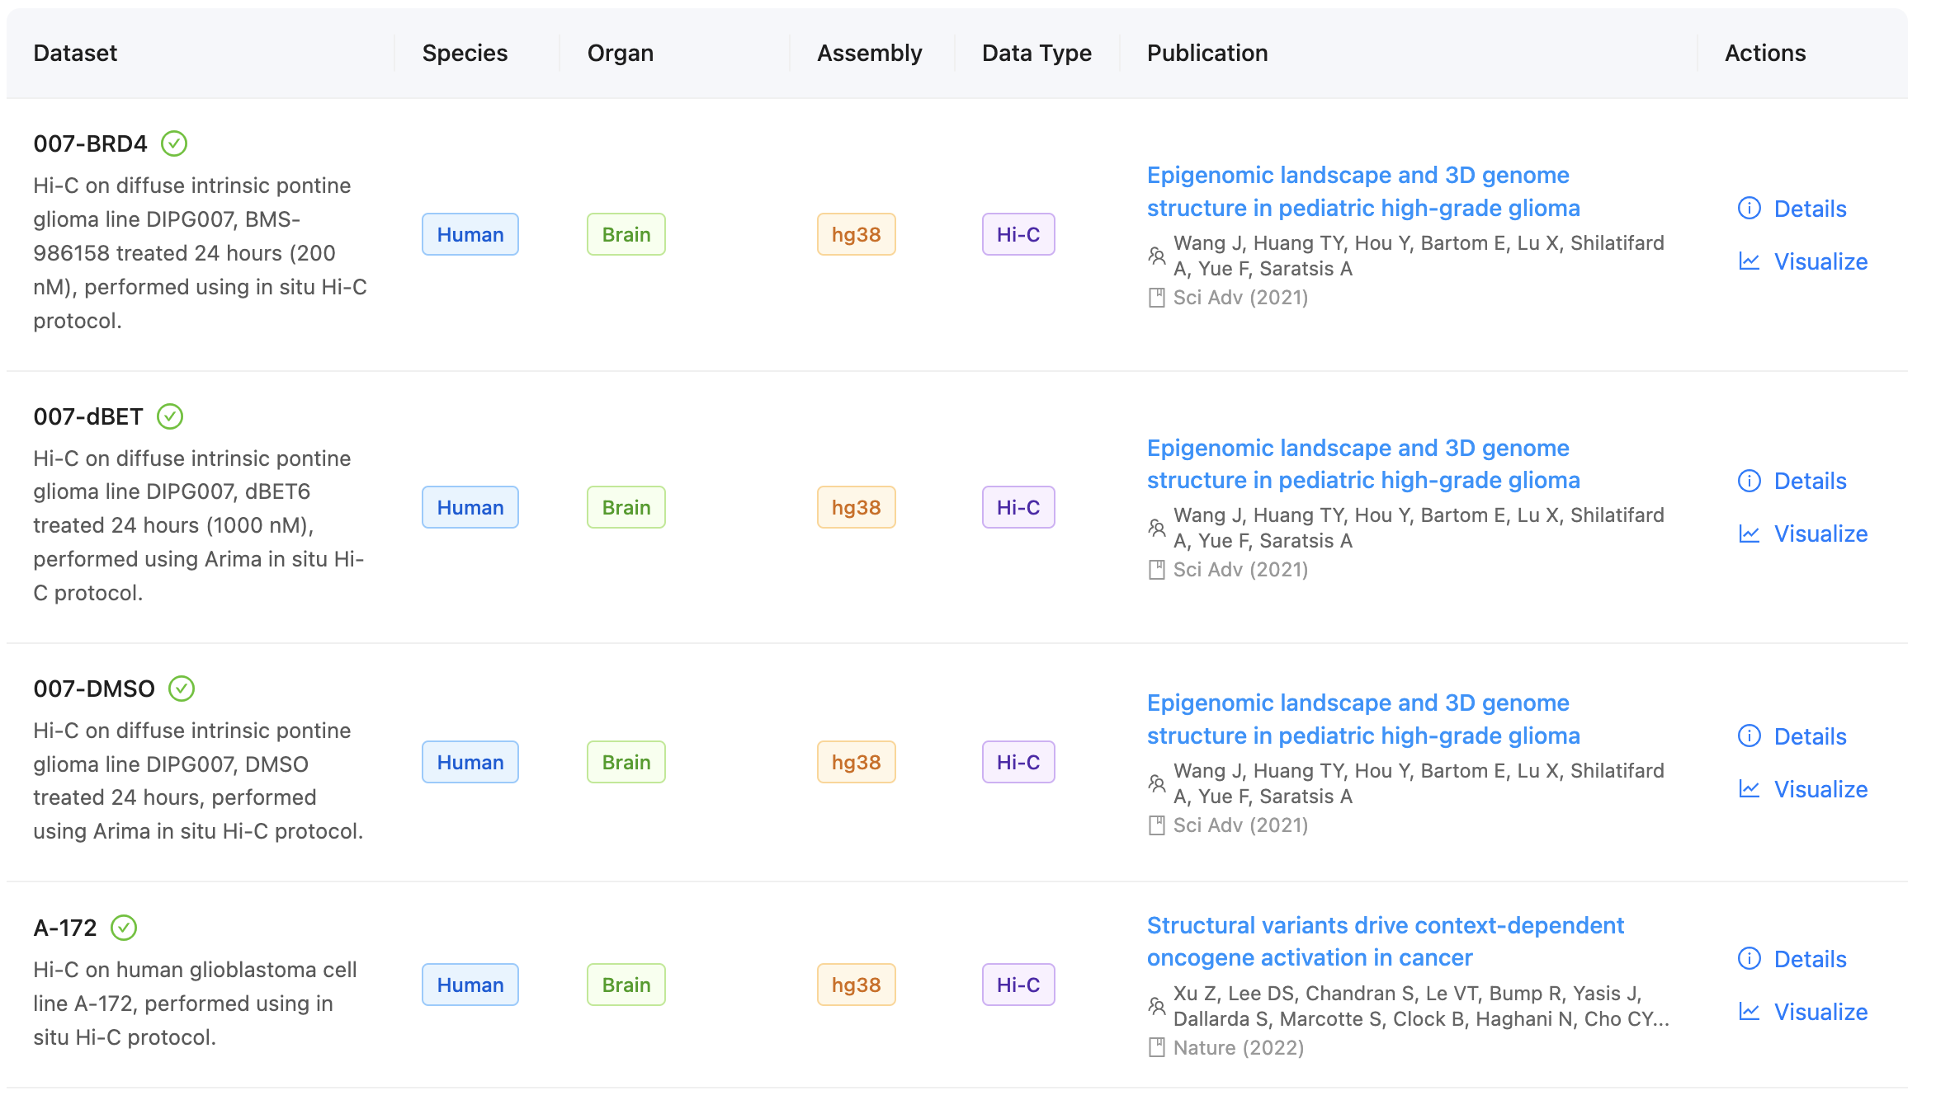
3D GENOME BROWSER

Slide 57
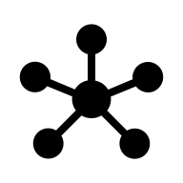
ENHANCER–PROMOTER INTERACTIONS
🧬 Hi-C maps physical contacts between regulatory elements and genes
🔗 Helps identify gene regulatory networks
📊 Integration with expression data reveals functional pathways

Slide 58
INTEGRATING GWAS WITH 3D GENOME DATA
📈 GWAS identifies disease-associated SNPs
🧬 Many SNPs are non-coding; 3D contacts link them to target genes
🔧 Tools like HUGIn and FUMA map SNPs via chromatin contacts

Slide 59
NETWORK REPRESENTATION
🖇️ Chromatin interactions can be modeled as graphs
📊 Nodes = genomic regions, Edges = contacts
🔍 Network analysis reveals hubs and modularity

Slide 60
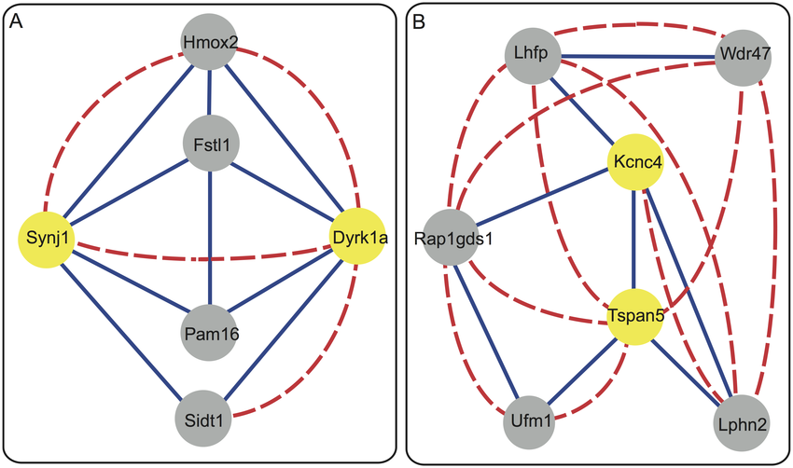
NETWORK REPRESENTATION

Slide 61
TOOLS FOR NETWORK ANALYSIS
📈 igraph: fast computation for large graphs
🔬 Cytoscape: visualization and integrative analysis
💡 Combine with chromatin and GWAS data for functional insights

Slide 62

MICROBIOMES AND METAGENOMES
🌱 Microbiome: community of microorganisms in an environment
🧬 Metagenomics: sequencing all genetic material
💡 Reveals composition and functional potential

Slide 63
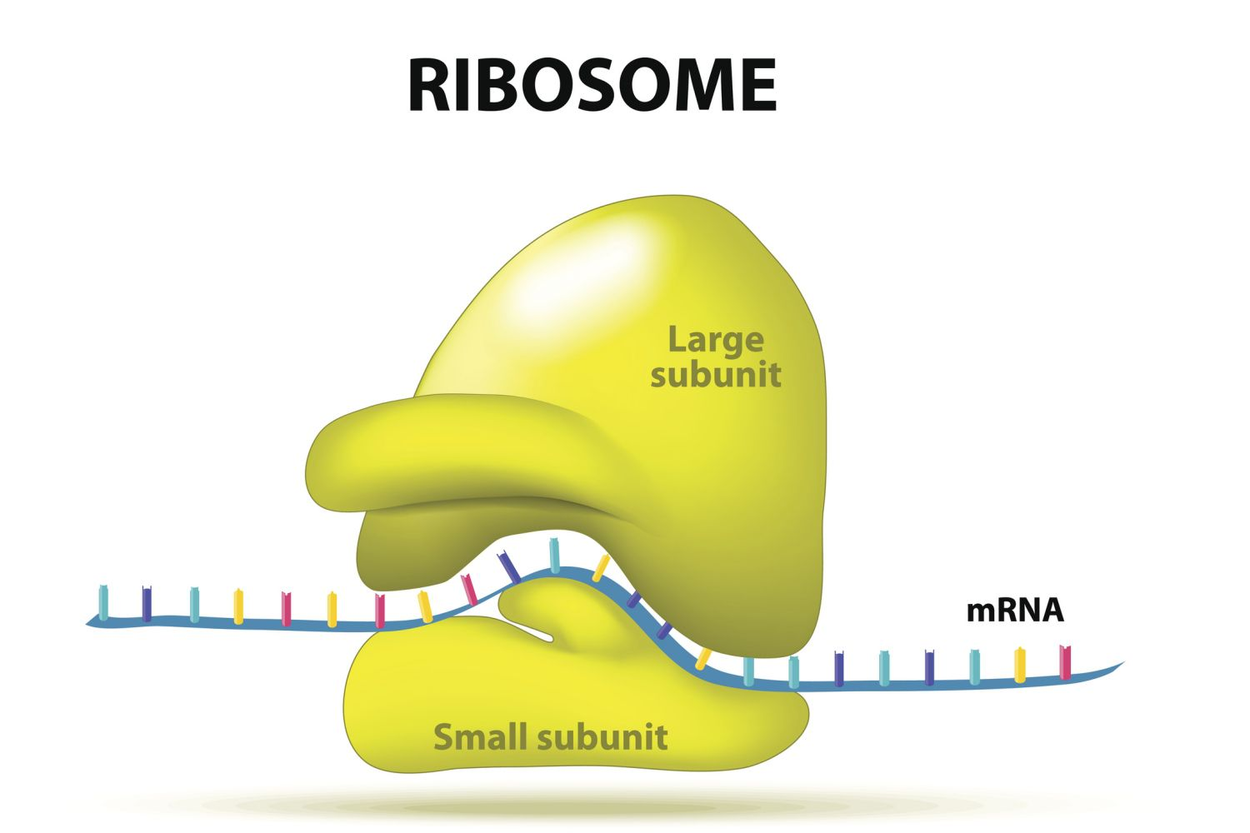
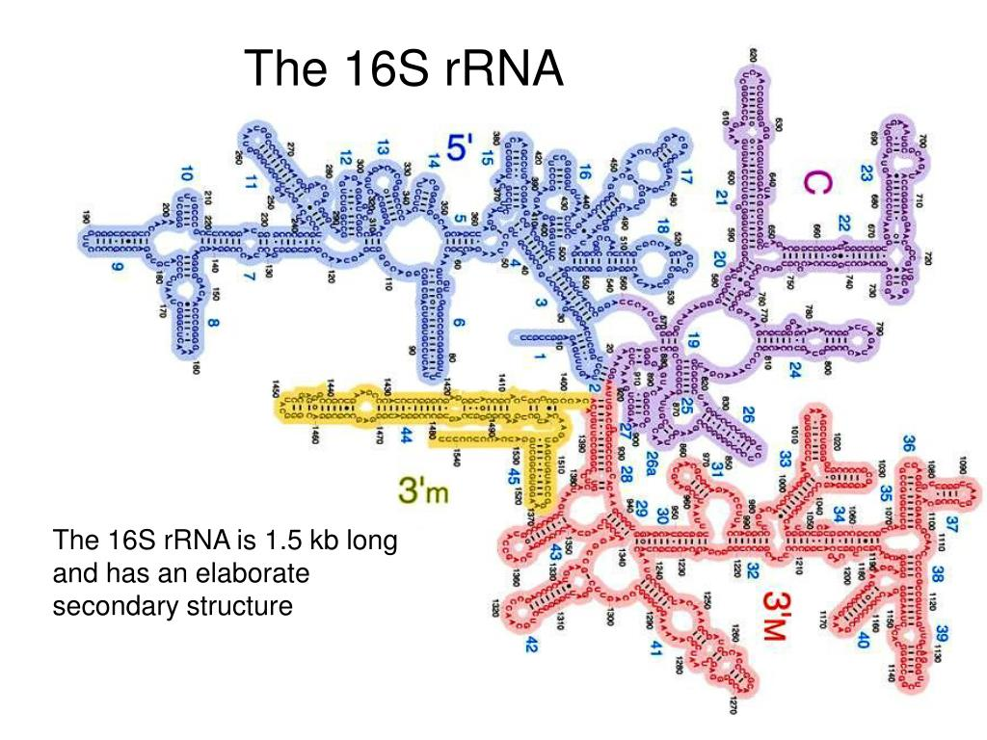
16S RRNA VS SHOTGUN METAGENOMICS

Slide 64
16S RRNA VS SHOTGUN METAGENOMICS
🧫 16S: targets conserved ribosomal gene for taxonomic profiling
🔬 Shotgun: sequences all DNA, including functional genes
💡 16S is cheaper but lower resolution

Slide 65
ASSEMBLY-BASED VS ASSEMBLY-FREE
💻 Assembly-based: reconstruct genomes from reads
📊 Assembly-free: k-mer and mapping approaches
🔧 Trade-offs: completeness vs computational efficiency

Slide 66
METAGENOMIC ASSEMBLY TOOLS
🧩 MetaSPAdes: tailored for complex metagenomes
⚡ MEGAHIT: ultra-fast assembler for large datasets
💻 Outputs contigs for downstream annotation

Slide 67
TAXONOMIC PROFILING TOOLS
🔍 Assign reads to taxa rapidly
🧬 Kraken2: k-mer exact matching
📊 MetaPhlAn: marker-gene based abundance profiling
⚡ Centrifuge: optimized for large datasets

Slide 68
FUNCTIONAL PROFILING
💻 HUMAnN3: maps reads to pathways and gene families
🧩 UniRef clusters proteins for efficient annotation
🔬 Allows identification of microbial metabolic potential

Slide 69
MICROBIOME–HOST INTERACTIONS
🧬 Microbial metabolites influence host signaling
🔥 Impacts immune system and inflammation
⚡ Modulates nutrient absorption and metabolism

Slide 70
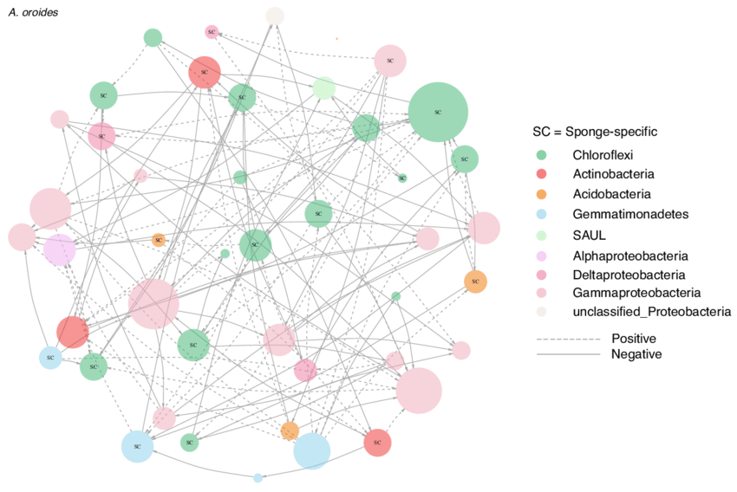
MICROBIOME NETWORKS

Slide 71
MICROBIOME NETWORKS
🖇️ Models microbial interactions as networks
📊 Identify keystone species and modules
🔍 Detect positive and negative associations
💡 Useful for functional ecology and synthetic community design

Slide 72
BIOINFORMATICS CHALLENGES
⚠️ Contaminants can bias results
📉 Compositional data requires special statistical handling
💻 High-dimensional datasets need efficient algorithms

Slide 73
LARGE-SCALE METAGENOME ANALYSIS
⚡ Terabytes of sequence data per study
💻 Requires HPC and optimized pipelines
🔧 Parallelized tools: MEGAHIT, Kraken2, HUMAnN3
💡 Speed, memory, and accuracy trade-off

Slide 74
DEEP LEARNING FOR MICROBIOMES
🤖 CNNs capture patterns in microbiome composition
🧠 Autoencoders learn latent features for clustering
📊 Predict host traits, disease status, or treatment response

Slide 75
DATABASES FOR METAGENOMICS
🌐 Repositories of metagenomic sequences and annotations
🔬 Include environmental, human, and host-associated datasets
💾 Provide metadata and functional annotations
💡 Facilitate comparative and integrative studies

Slide 76
DATABASES FOR METAGENOMICS
Database | Description
MGnify | Formerly EBI Metagenomics; comprehensive microbial analysis
IMG | Host-associated and environmental metagenomes
NCBI SRA | Raw sequencing reads from various studies
MetaPhlAn | Marker gene database for taxonomic profiling
EMP | Global environmental microbiome datasets
HMP | Human-associated microbiomes

Slide 77
MICROBIOME VISUALIZATION TOOLS
📊 Krona: interactive hierarchical plots
🖥️ Anvi’o: visualization and binning of contigs
🔍 MetaCompass: alignment-based visualization
💡 Helps explore complex microbial communities

Slide 78
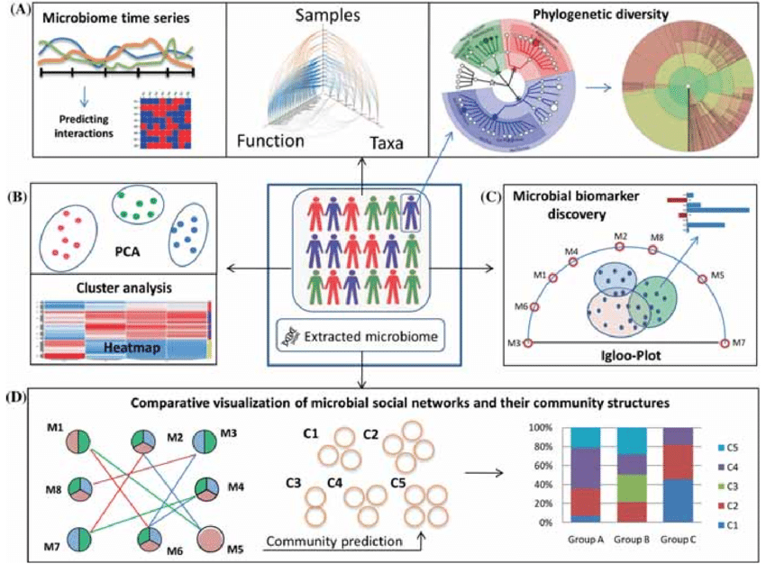
MICROBIOME VISUALIZATION TOOLS

Slide 79
MULTI-OMICS INTEGRATION
🔗 Combines microbiome, transcriptome, methylome data
📊 Correlates microbial pathways with host gene regulation
🧬 Reveals causal hypotheses for health and disease

Slide 80
3D GENOME AND MICROBIOME
💭 Consider multi-layered interactions: DNA ↔ RNA ↔ Microbiome
🔍 How to link physical 3D contacts to microbial effects?
🧩 Can deep learning help in predicting cross-omics interactions?

Slide 81

DNA TOPOLOGY, RNA/DNA STRUCTURE
🧬 Reviewed DNA topology and polymer physics
🧩 Explored RNA secondary/tertiary structures and pseudoknots
📊 Covered Hi-C and chromatin interaction techniques with computational tools

Slide 82
KEY TOOLS, DATABASES, AND ALGORITHMS
💻 Computational tools: NetworkX, HiCCUPS, Fit-Hi-C, MetaSPAdes, Kraken2
🌐 Databases: 4D Nucleome, ENCODE, RNAcentral, PDB, MGnify
🤖 Deep learning models: Akita, DeepC, Autoencoders for microbiome

Slide 83
OPEN QUESTIONS
💭 How predictive are 3D contacts for gene expression?
🔍 Can microbiome and host genomics be integrated reliably?
🤖 What is the role of AI in multi-omics prediction?

